Slide 1
Food Order System
Doughnut Store
Henry, Kaleem, Ivo and Lukman

Slide 2
Food Order System
Sections
Requirements Analysis
Design
User Acceptance
Team working Strategy

Slide 3
Requirements

Slide 4
Requirements
Our process
Split Sections
Noted down ideas within each section
Expanded points and provided evidence

Slide 5
Requirements
Stakeholders
Customer
Chef
Driver/Checkout Staff
Admin

Slide 6
Requirements
Non-Functional
Product
Speed
Navigable
Functional on both desktop and mobile
Organisational
Companies typeface and colour scheme
Precept of purchase
External
GDPR

Slide 7
Requirements
Functional - Customer Site
Ordering food from website
Storing Customer accounts
Payment For Orders
Viewing previous orders

Slide 8
Requirements
Functional - Store Site
Chefs and view current orders
Customer details
Confirming Completion
Amending meu items
Add/ Remove menu items

Slide 9
Requirements
Use Cases
Customer
Order Food
Chef
View Order
Driver/Checkout Staff
Complete Order
Admin
Amend Item
Add item
Remove Item

Slide 10
Design

Slide 11
Design
Problems With Existing System
Long winded Process
Unable to see a copy of the menu when ordering
No validation possible that the items were sent to the correct address

Slide 12
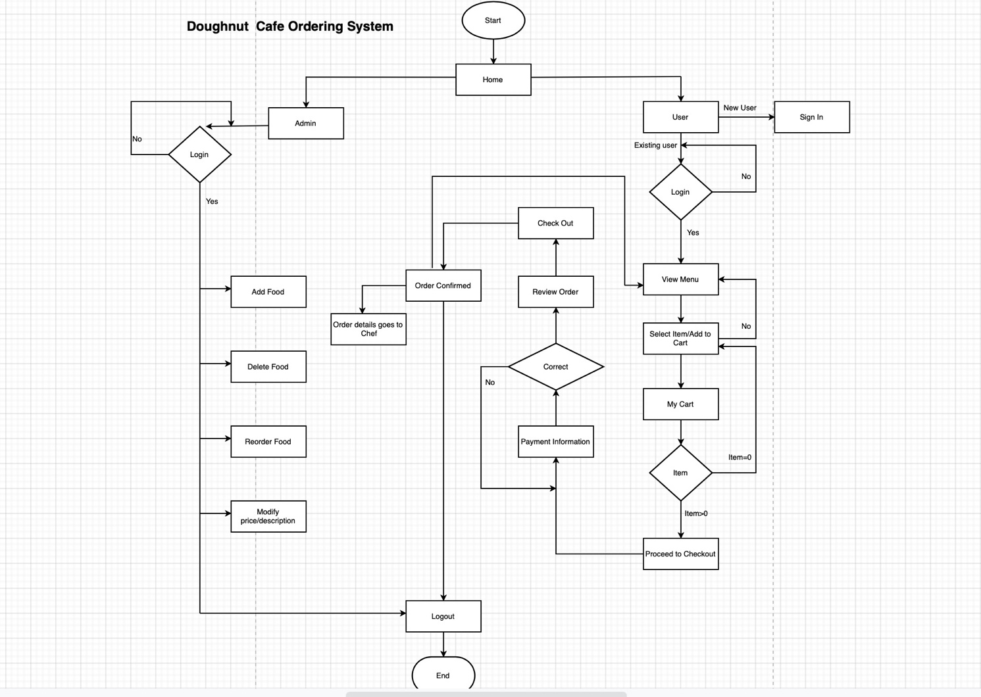
Design
Flow Chart for the Ordering Process in the New System

Slide 13
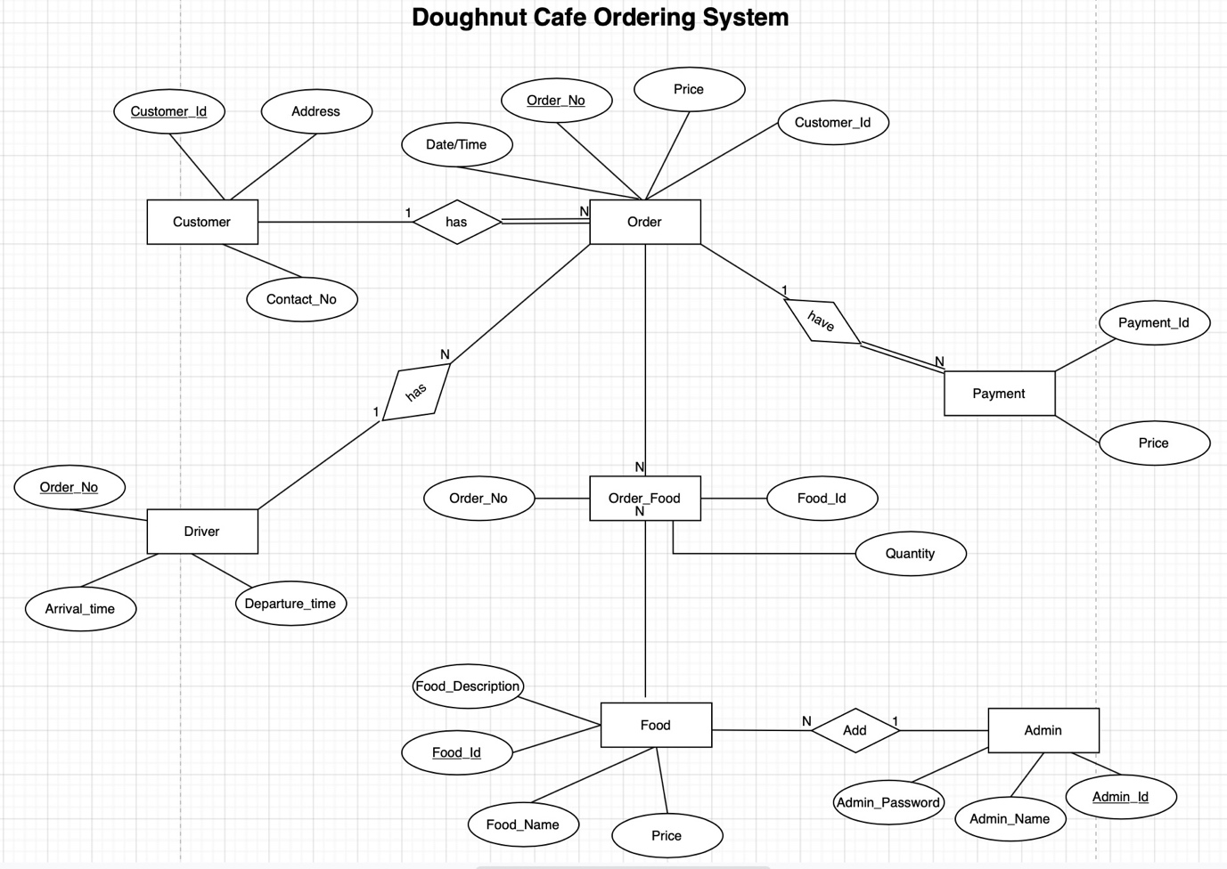
Design
ER Diagram for the New System

Slide 14
User Acceptance Criteria

Slide 15
Team Working Strategy

Slide 16
Team Working Strategy
Team Leader
One (sometimes more) needs to make the calls
To split the weight of the project
Coach each team member
Henry

Slide 17
Team Working Strategy
Assigning Roles
Requirements Analysis
Design
User Acceptance
Team Working Strategy
Even split without disagreements

Slide 18
Team Working Strategy
Communication
Teams for calls some shared files and notes
Scheduled group call
No face to face currently
Forced to work remotely

Slide 19
Team Working Strategy
Working Together
Github
Sharing the file we are working in
Share work part at a time

